Slide 1
12/3/2020, Updated 12/12/20
Glove Conservation With a Centralized Approach
COVID-19 |

Slide 2
FDA Medical Glove Conservation Strategies
Conventional & Contingency Practices
FDA has provided information for Conventional, Contingency and Crisis Capacity Strategies with regard to examination gloves. The information below is directly from the FDA website
Conventional capacity: measures consist of providing patient care without any change in daily contemporary practices. This set of measures, consisting of engineering, administrative and PPE controls should already be implemented in general infection prevention and control plans in healthcare settings.
Use FDA-cleared medical gloves according to labeling and federal, state and local requirements.
Nonsterile disposable patient examination gloves, which are used for routine patient care in healthcare settings, are appropriate for the care of patients with suspected or confirmed COVID-19.
Employ engineering and administrative controls following the CDC and HICPAC guidelines to reduce the need for medical gloves while minimizing risks to healthcare providers and patients. Some of the CDC's Strategies for Optimizing the Supply of N95 Respirators may also be useful for gloves conservation.
Reserve use of sterile gloves for procedures in which sterility is required.
Contingency capacity: are implemented when limited supply levels may change patient care, but may not have a significant impact on patient care or healthcare provider safety.
For training or demonstration in which broad barrier protection is not needed, use medical gloves that are beyond the manufacturer-designated shelf life, if available.
Reference: Medical Glove Conservation Strategies: Letter to HealthCare Providers Posted 4.27.2020 Available at: https://www.fda.gov/medical-devices/letters-health-care-providers/medical-glove-conservation-strategies-letter-health-care-providers
Accessed 11.30.2020
IMPORTANT NOTICE: The content in this communication is provided for informational purposes only and intended for its direct recipients. Due to the urgent and dynamic nature of the COVID-19 pandemic, the potential member best practices, experimental techniques, and other materials below may be preliminary, evolving and subject to change. Nothing herein is intended to replace health system practices and independent clinical decision-making, which are the sole responsibility of systems and their practitioners. HealthTrust, on behalf of itself and any members that have provided this content, expressly disclaims any liability for health system operational and treatment decisions.

Slide 3
FDA Medical Glove Conservation Strategies
Crisis or Alternate Strategies
These strategies can be implemented when supply is critically low and cannot meet the facility’s current or anticipated PPE utilization rate.
Refer to the CDC's hand hygiene in healthcare settings
Use medical gloves beyond the manufacturer-designated shelf life in a setting where there is a lower risk of transmission if feasible (for example, non-surgical, non-sterile, patients with no known COVID-19 diagnosis). The user should visibly inspect the gloves prior to use and, if there are concerns (for example, discolored or visible tears, holes), discard the gloves.
Extend the use of medical gloves without changing the gloves between patients with no known infectious diseases. Gloved hands should be cleaned between patients and at other times when hand hygiene would normally be performed during routine patient care. Alcohol-based hand sanitizers may degrade vinyl gloves. If a glove becomes damaged (for example, discolored, deteriorated, visible tears, holes), contaminated (for example, body fluids, chemotherapy drugs) or no longer provides a liquid barrier, replace it.
Consider using radiographic protective gloves or radiation attenuating surgeon's gloves that are clean and offer fluid barrier protection. These gloves cannot be sterilized but can be cleaned following the manufacturer's labeling.
Consider using non-medical gloves such as those used for food service, embalming, cleaning, or other industrial-grade gloves that most closely align with the ASTM standards for medical gloves as outlined in the FDA's Medical Glove Guidance Manual.
Be aware that counterfeit medical and non-medical gloves may be on the market, especially during this time of increased demand.
Reference: Medical Glove Conservation Strategies: Letter to HealthCare Providers Posted 4.27.2020 Available at https://www.fda.gov/medical-devices/letters-health-care-providers/medical-glove-conservation-strategies-letter-health-care-providers Accessed 11.30.2020
IMPORTANT NOTICE: The content in this communication is provided for informational purposes only and intended for its direct recipients. Due to the urgent and dynamic nature of the COVID-19 pandemic, the potential member best practices, experimental techniques, and other materials below may be preliminary, evolving and subject to change. Nothing herein is intended to replace health system practices and independent clinical decision-making, which are the sole responsibility of systems and their practitioners. HealthTrust, on behalf of itself and any members that have provided this content, expressly disclaims any liability for health system operational and treatment decisions.

Slide 4
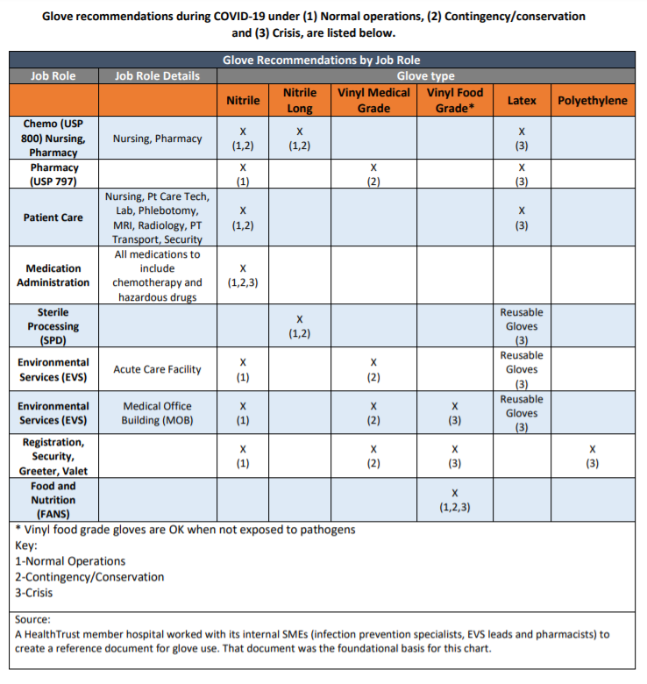
HealthTrust Resource: Glove Recommendations by Job Role
Download the Glove Recommendation Resource
IMPORTANT NOTICE: The content in this communication is provided for informational purposes only and intended for its direct recipients. Due to the urgent and dynamic nature of the COVID-19 pandemic, the potential member best practices, experimental techniques, and other materials below may be preliminary, evolving and subject to change. Nothing herein is intended to replace health system practices and independent clinical decision-making, which are the sole responsibility of systems and their practitioners. HealthTrust, on behalf of itself and any members that have provided this content, expressly disclaims any liability for health system operational and treatment decisions.

Slide 5

Maintain Controlled Centralized Access Supplies
Supply chain should develop a process for dispensing appropriate levels of PPE to units & personnel daily based on unit needs & job role.
Sample Process: PPE Disbursement
Exam Gloves
Centralized PPE
Location(s)
Note: All units receive appropriate exam gloves based on par levels for patient population and duties
Collect Any Excess Exam Gloves from each area based on specific need in each unit
Unit Managers & Department Managers
Distribute to staff based on need for situation and job role
Employees
IMPORTANT NOTICE: The content in this communication is provided for informational purposes only and intended for its direct recipients. Due to the urgent and dynamic nature of the COVID-19 pandemic, the potential member best practices, experimental techniques, and other materials below may be preliminary, evolving and subject to change. Nothing herein is intended to replace health system practices and independent clinical decision-making, which are the sole responsibility of systems and their practitioners. HealthTrust, on behalf of itself and any members that have provided this content, expressly disclaims any liability for health system operational and treatment decisions.

Slide 6
Process for Collection & Inventory
Centralization & Distribution
PPE Task Force and Supply Chain to evaluate level of exam glove needed for each area, including type of glove by task.
Remove and centralize exam gloves from all locations who do not routinely use these gloves.
Ensure all locations are assessed and only appropriate gloves are stocked in each unit.
PPE Task Force to educate departments on appropriate exam glove use.
Supply Chain to baseline consumption exam gloves and enter into tracker using the HealthTrust PPE calculator.
Supply Chain adjusts tracker to account for current levels to ensure overall consumption can be tracked.
PPE Task Force to review/report out daily consumption of exam gloves to understand how consumption is impacted and to detect any early warning signs of a spike in use.
Task Force members follow up with departments who are outliers in consumption.
Collect Exam Gloves
Distribute based on Considerations
IMPORTANT NOTICE: The content in this communication is provided for informational purposes only and intended for its direct recipients. Due to the urgent and dynamic nature of the COVID-19 pandemic, the potential member best practices, experimental techniques, and other materials below may be preliminary, evolving and subject to change. Nothing herein is intended to replace health system practices and independent clinical decision-making, which are the sole responsibility of systems and their practitioners. HealthTrust, on behalf of itself and any members that have provided this content, expressly disclaims any liability for health system operational and treatment decisions.

Slide 7
Appropriate Glove use by Activity
Single layer exam glove to protect from contact with
Activities safely performed without gloves
Blood or body fluids
Mucus membranes
Non-intact skin, lacerations, punctures
Potentially infectious materials
Contaminated skin
Contaminated equipment
Soiled linen
Chemicals & disinfectants
Touching intact skin
Taking vital signs
Changing dry linen
Ambulating a patient
Transporting a patient
Entering a non-isolation room
Touching equipment (IV, monitor)
Between doffing steps
Administering oral medication
COVID-19 Vaccine administration
Resource: Hand Hygiene in Healthcare Settings. CDC Available at: ttps://www.cdc.gov/handhygiene/providers/index.html#:~:text=Gloves%20are%20not%20a%20substitute,hygiene%20immediately%20after%20removing%20gloves. Accessed 12.2.2020
CDC COVID-19 Vaccine Training Module. CDC Available at :
https://www2.cdc.gov/vaccines/ed/covid19/SHVA/40030.asp Accessed 12.12.2020
IMPORTANT NOTICE: The content in this communication is provided for informational purposes only and intended for its direct recipients. Due to the urgent and dynamic nature of the COVID-19 pandemic, the potential member best practices, experimental techniques, and other materials below may be preliminary, evolving and subject to change. Nothing herein is intended to replace health system practices and independent clinical decision-making, which are the sole responsibility of systems and their practitioners. HealthTrust, on behalf of itself and any members that have provided this content, expressly disclaims any liability for health system operational and treatment decisions.

Slide 8
Considerations for Double Gloving
Double gloving is a practice initiated to avoid exposure during invasive procedures.
AORN 2020 guideline revisions stated the following:
While previously recommended double-gloving to reduce the risk for sharps injury and potential exposure to bloodborne pathogens, the revised guideline for Sharps Safety strengthens this recommendation by citing a new systematic review of randomized controlled trials on double gloving. The review includes evidence that glove perforations were reduced by 71% when wearing two pairs of gloves compared to wearing only one.
CDC Guidance for Surgical Hand Antisepsis
Double gloving is advised during invasive procedures, such as surgery, that pose an increased risk of blood exposure
Considerations:
This practice should be evaluated by an interdisciplinary team to include representation from infection prevention, surgical nursing, anesthesia, surgeons and supply chain.
Specific guidelines for this practice should be developed and education provided to all staff.
Intermittent rounds to monitor utilization should be performed to ensure compliance with health system established guidelines.
Reference: AORN Guideline revisions for 2020: 7 Things to Know. (2019). Available at https://www.aorn.org/about-aorn/aorn-newsroom/periop-today-newsletter/2019/2019-articles/guideline-revisions-for-2020 Accessed 12.1.2020.
Hand Hygiene in Healthcare Settings. CDC Available at: https://www.cdc.gov/handhygiene/providers/index.html#:~:text=Gloves%20are%20not%20a%20substitute,hygiene%20immediately%20after%20removing%20gloves. Accessed 12.2.2020
IMPORTANT NOTICE: The content in this communication is provided for informational purposes only and intended for its direct recipients. Due to the urgent and dynamic nature of the COVID-19 pandemic, the potential member best practices, experimental techniques, and other materials below may be preliminary, evolving and subject to change. Nothing herein is intended to replace health system practices and independent clinical decision-making, which are the sole responsibility of systems and their practitioners. HealthTrust, on behalf of itself and any members that have provided this content, expressly disclaims any liability for health system operational and treatment decisions.

